Slide 1
Chrome OS
Mark Harming
CET 751

Slide 2
Chrome OS
Chrome OS released by Google 6-15-11
A new OS
To compete with Windows, Mac, etc…

Slide 3
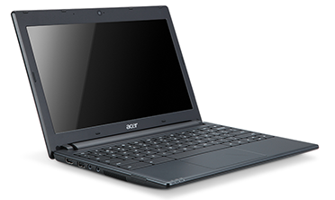
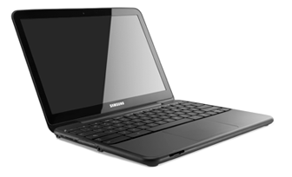
Offered by
ACER
SAMSUNG
11.6" HD Widescreen CineCrystalTM LED-backlit LCD
3.19 lbs | 1.45 kg
6 hours of continuous usage ¹
Intel® AtomTM Dual-Core Processor
Built in dual-band Wi-Fi and World-mode 3G (optional)
12.1" (1280x800) 300 nit Display
3.26 lbs / 1.48 kg
8.5 hours of continuous usage ¹
Intel® AtomTM Dual-Core Processor
Built in dual-band Wi-Fi and World-mode 3G (optional)

Slide 4
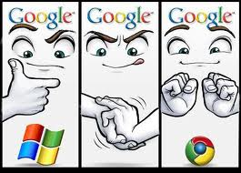
Chrome OS Goals
Speed
Simplicity
Security

Slide 5
Speed
Start up time
8 seconds from turned off to running.
2-3 seconds time from sleep

Slide 6
Simplicity
Essentially – the computer is a web browser.
All programs run over the web.
Lightweight
Long Battery Life

Slide 7
Security
Sandboxing –each tab runs in it’s own “sandbox”, applications are unable to interact with others.
No data is stored locally, all stored in the cloud and encrypted
Automatic Updates – every time you start a Chromebook, updates run automatically.

Slide 8
Security Cont…
4. Always start with a clean slate
-A system check is run at every start up
-If malware or other anomalies are found, the system will install an updated version from the cloud.
5. No desktop applications – everything runs in the browser, so no programs can be infected.

Slide 9
Solid State Drive
All Chromebooks Utilize SSD’s
Faster
Better Shock Resistance
Longer Battery Life
Less Heat Generated
No Moving Parts

Slide 10
Negatives
Inability to work offline
HUGE negative for many
Google claims some apps will be able to run off line, but this will be limited.
Cost – tablets available already are cheaper, and have ability to work offline

Slide 11
Other Negatives
If you don’t like the Chrome Browser, you’re out of luck.
It’s different – people set in their ways may not like this.

Slide 12
Overall
Seems like a good system for “casual” computer users.
Those who use their computers for shopping, e-mail, facebook, etc…
With Microsoft’s Sky Drive, and Apple’s forthcoming “Cloud” – this does seem like the way things are trending.

