Slide 1
Second Life Exploration
The Adventures of Mark Cardboard

Slide 2
Second Life
Overall, I was very disappointed with Second Life.
It was difficult to move my avatar around in the system.
When I went to teleport to various places, I wasn’t allowed to go.
I really struggled with this program.

Slide 3
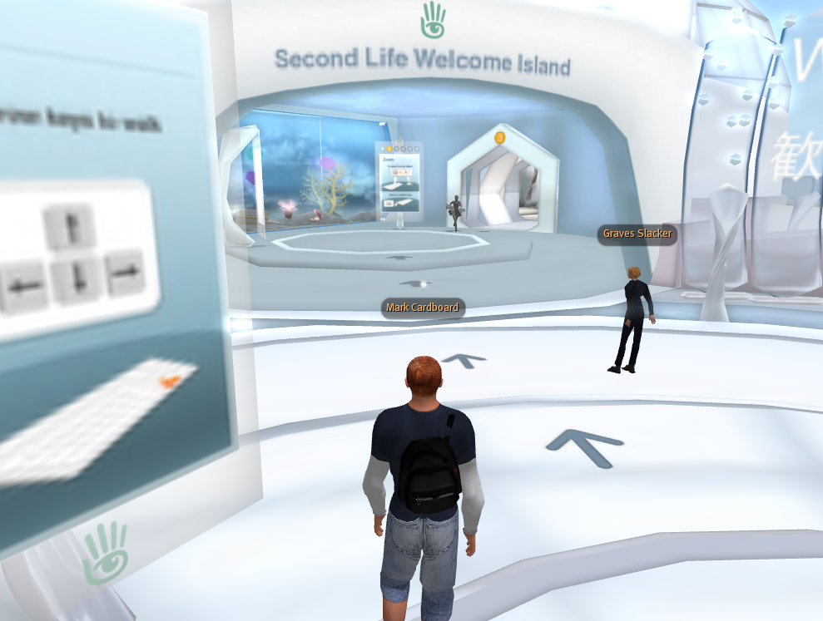
Screen Capture
Here I am at Welcome Island, trying to figure out what to do.

Slide 4
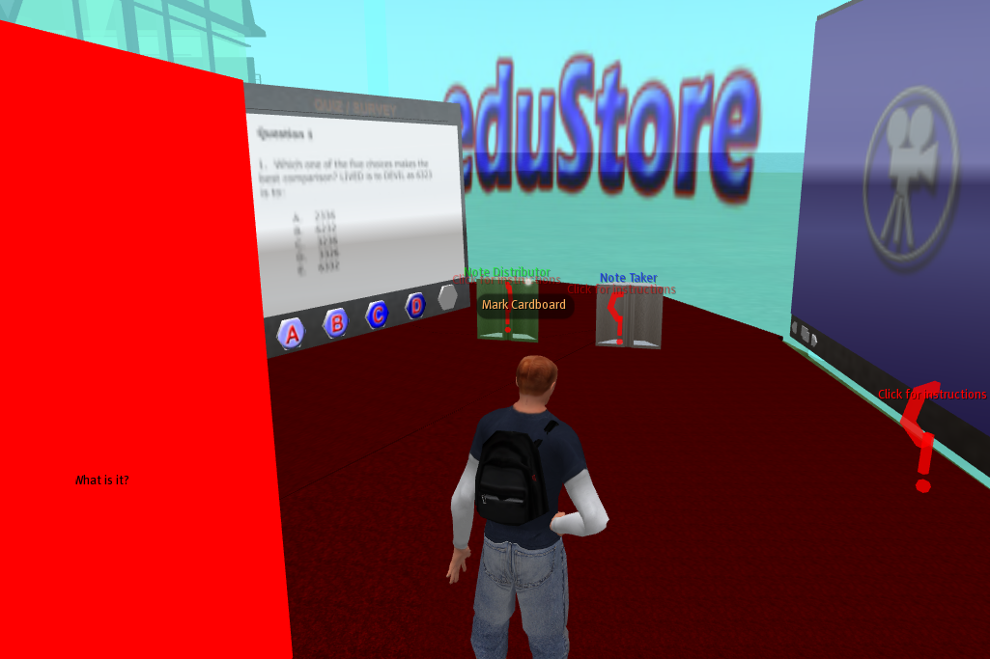
Second Capture
The first place I went upon arrival was the edu store. I thought they might have some educational products, but it was very confusing, and there were very poor instructions in how to use anything.

Slide 5
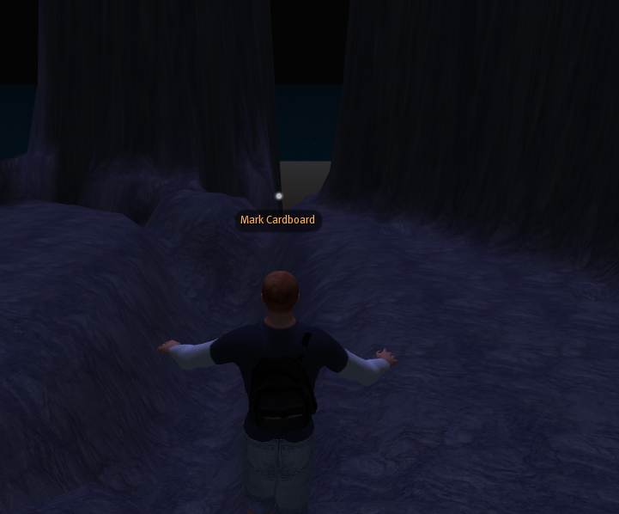
Third Capture
When I typed in NASA, and teleported there I was taken here. There were no other people around, and no buildings, and it was really strange.

Slide 6
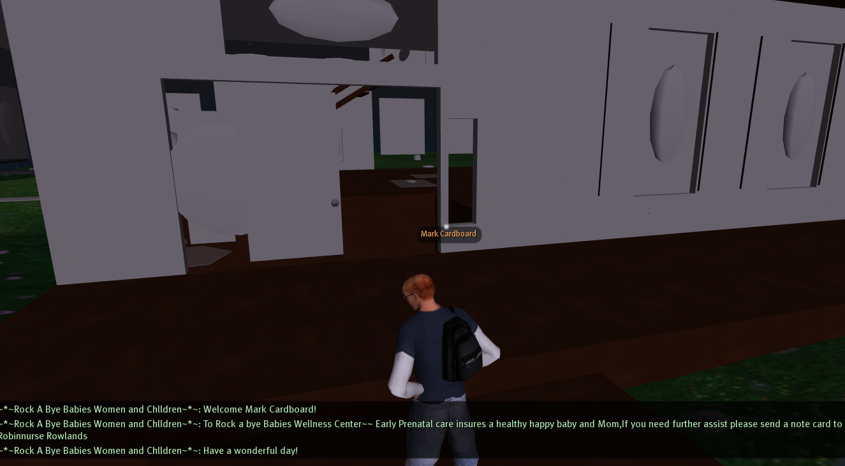
Fourth Capture
My Final Destination was Wellness Island. I was finally able to enter the Rock a Bye Babies Wellness Center.

Slide 7
Final Thoughts
Although Second Life seems like it could be an interesting program, it is very difficult for the novice user.
I would not recommend using this in an educational setting, unless you were highly trained in it.
Lastly, I’m sure that there is a great deal of good information on there, and that this is a neat and interactive way to reach it, but the graphics and animation seem “outdated” in the age of playstation 3, and xbox 360.

